Slide 1
Using Components 2D Vector Analysis
The Components of a Vector
Adding and Subtracting Vectors using components

Slide 2
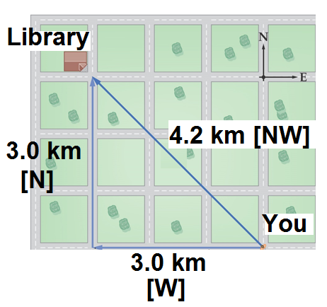
The Components of a Vector
Consider the diagram below: The library is 4.2 km [NW] of your location. How will you get there?
Walk 3.0 km [W] and then 3.0 km [N].

Slide 3
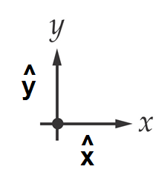
Cartesion Components:
In a 2D plane, we can define a co-ordinate system made up of 2 orthogonal (________________) unit vectors:
perpendicular
Unit vector-
Means they are 1 unit long
break down
We can ____________ or _____________ any vector in a 2D plane into _______________ in each unit vector direction:
resolve
components

Slide 4
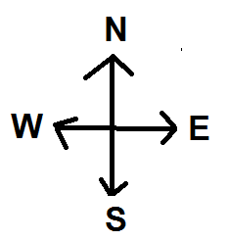
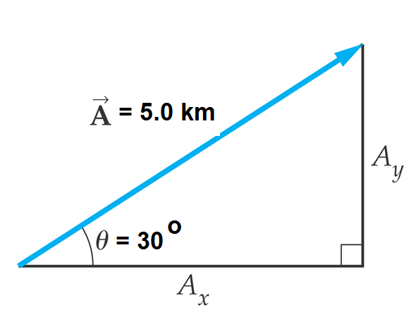
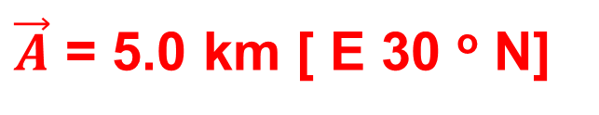
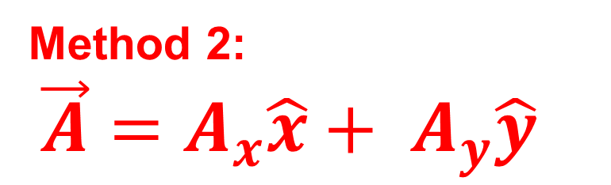
Position vector Vector A can be written two ways:
Method 2:
$\vec{A}=A_{x}\hat{x}+ A_{y}\hat{y}$
Method 1:
magnitude [angle]
$\vec{A}$ = 5.0 km [ E 30 º N]

Slide 5
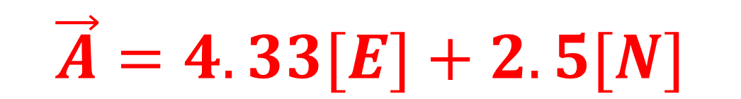
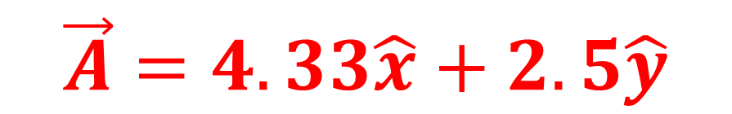
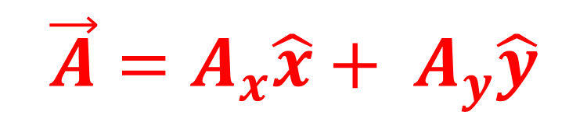
We can find the values of Ax and Ay using Trig!
$$\vec{A}=A_{x}\hat{x}+ A_{y}\hat{y}$$
Let E= +x
Let N= +y
$$\vec{A}=4.33\hat{x}+2.5\hat{y}$$
$$\vec{A}=4.33[E]+2.5[N]$$
Ax = A cosθ
= 5.0 cos 30°
=4.33 km
Ay = A sinθ
= 5.0 sin 30°
=2.5 km

Slide 6
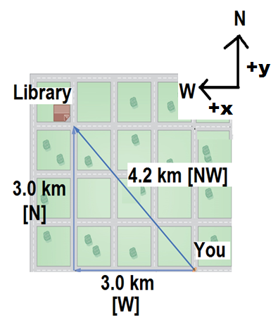


The Components of a Vector
Back to the library displacement! We can represent the displacement using components!
Let West be +x
Let North be +y
$$\vec{∆d}=3.0 km \hat{x}+3.0 km \hat{y}$$
$$\vec{∆d}=3.0 km \left[W\right]+3.0 km [N]$$

Slide 7
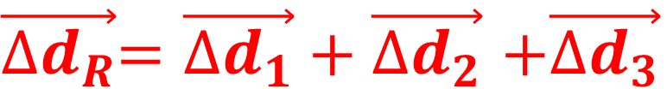


Adding vectors using components!
$\vec{{∆d}_{R}}=\vec{{∆d}_{1}}+\vec{{∆d}_{2}}$ $+\vec{{∆d}_{3}}$
Find the x and y components for each vector:
e.g. ${∆d}_{1x},{ ∆d}_{1y}$ etc.
Add up all of the x and y components:
$${∆d}_{Rx}={∆d}_{1x}+{∆d}_{2x}+{∆d}_{3x}$$
$${∆d}_{Ry}={∆d}_{1y}+{∆d}_{2y}+{∆d}_{3y}$$

Slide 8
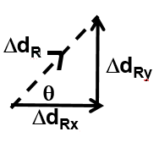
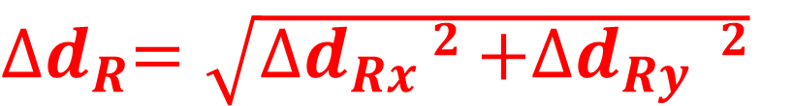

Sketch the total x and y components and use Pythagorean Theorem & SOHCAHTOA to write in magnitude angle form.
${∆d}_{R}=\sqrt{{∆d}_{Rx }2{+∆d}_{Ry }2}$
$$θ=\tan^{−1}{\frac{{∆d}_{Ry }}{{∆d}_{Rx }}}$$

